Slide 1
CSCI 473 HW_03
By: Ryan McCormick

Slide 2
This assignment we were tasked with writing two files that could make and print 2D arrays. The next part was to modify a few of the functions from the MyMPI.c/.h files so that they could be called from the test-mpi-read.c file to read and print a matrix in parallel. The next step was to test this for as many normal and edge cases as possible.
NOTE: The run_example.sh script will run and demonstrate the functionality of the project.
I started with the make-2d.c and got it to output a matrix, along with its meta data to a file.
Next, I wrote print-2d.c, this was able to read the binary data in the file produced by the make-2d.c and print it, formatted as a matrix to the command line.
The next step was to get the functions from the MyMPI.c/.h files and modify them as specified in the documentation.
I pulled each of the functions out, along with any other functions they called and added them to my own functions.c/.h files. This allowed me to better understand what was happening in each of the functions and how they were being implemented.
I added the my_free() function as needed, along with the my_allocate2d().
After these were written and the existing functions were modified as needed, I began testing all the possible cases.

Slide 3
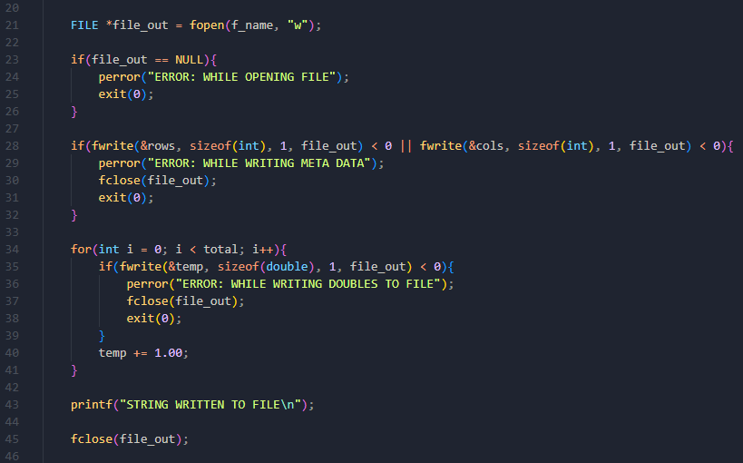
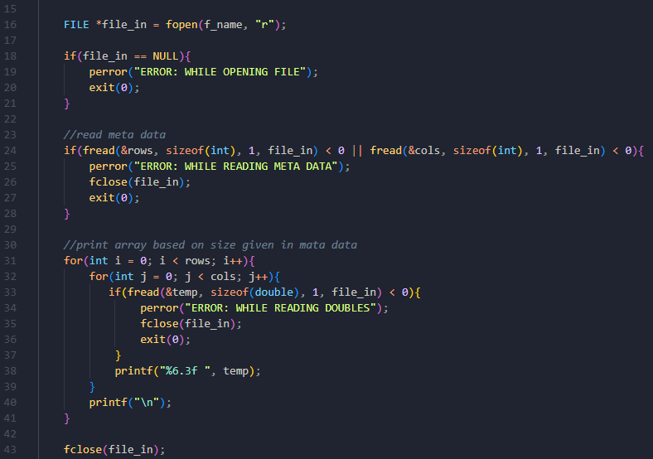
make-2d.c
print-2d.c

Slide 4
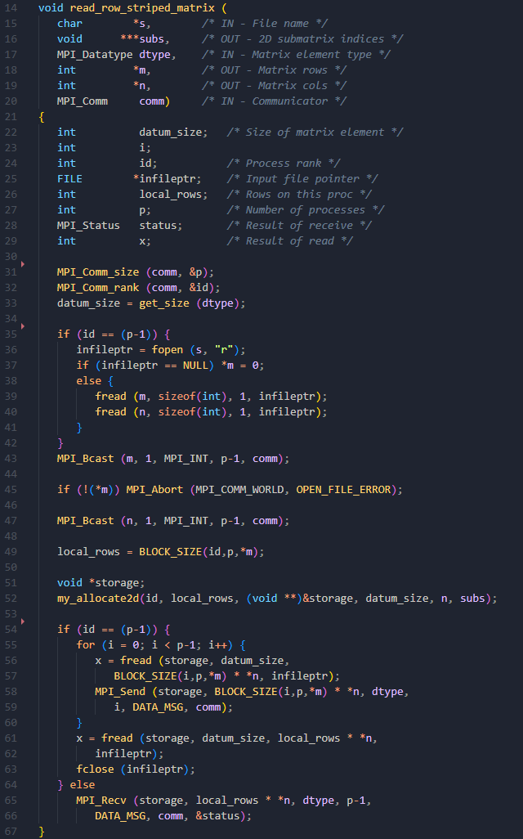
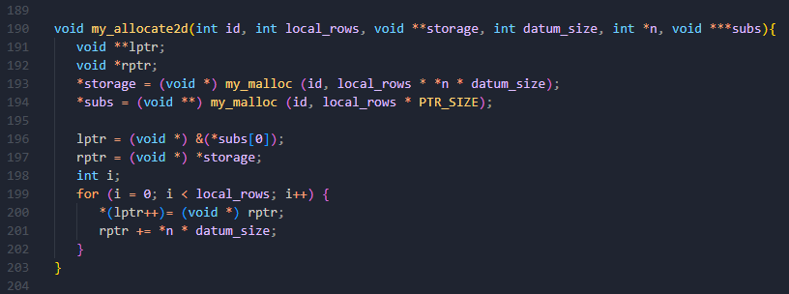
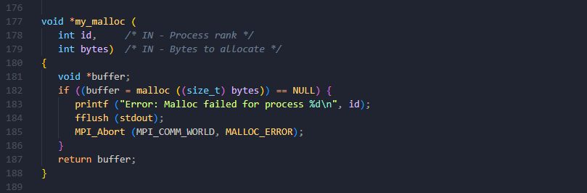
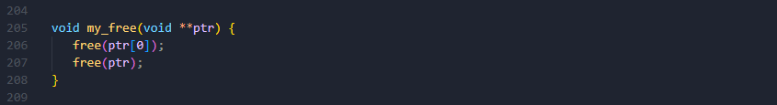

Slide 5
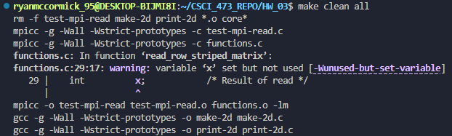
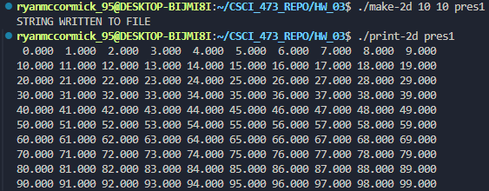
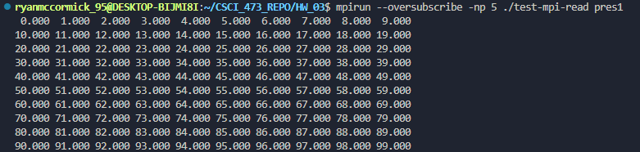

Slide 6
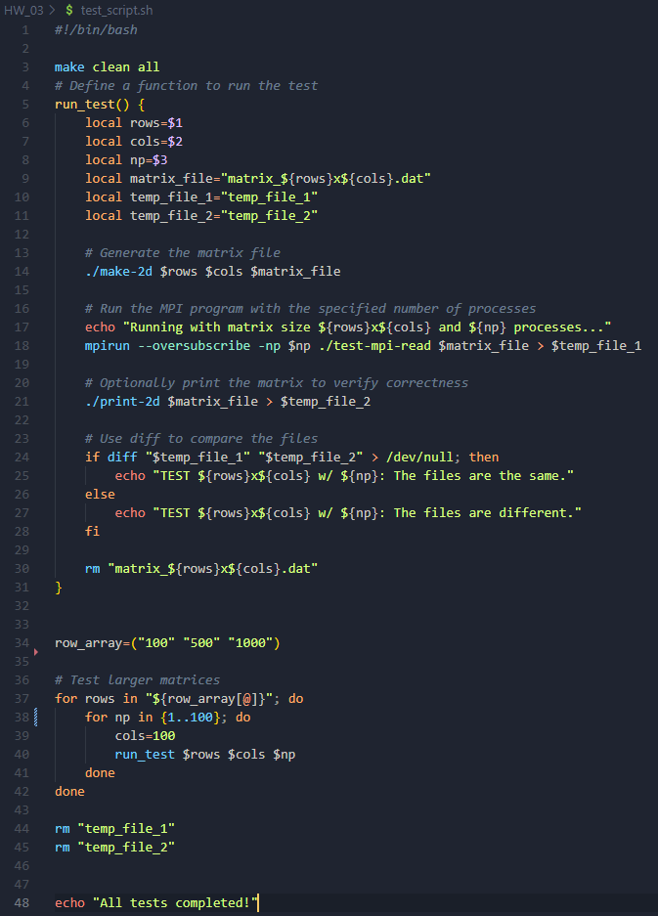
This script allowed me to test various combinations of rows, columns, and processors.
It then writes the matrices to temp files that are diffed to verify that they are the same.
This allowed me to test a variety of combinations much faster than I could by hand.

Slide 7
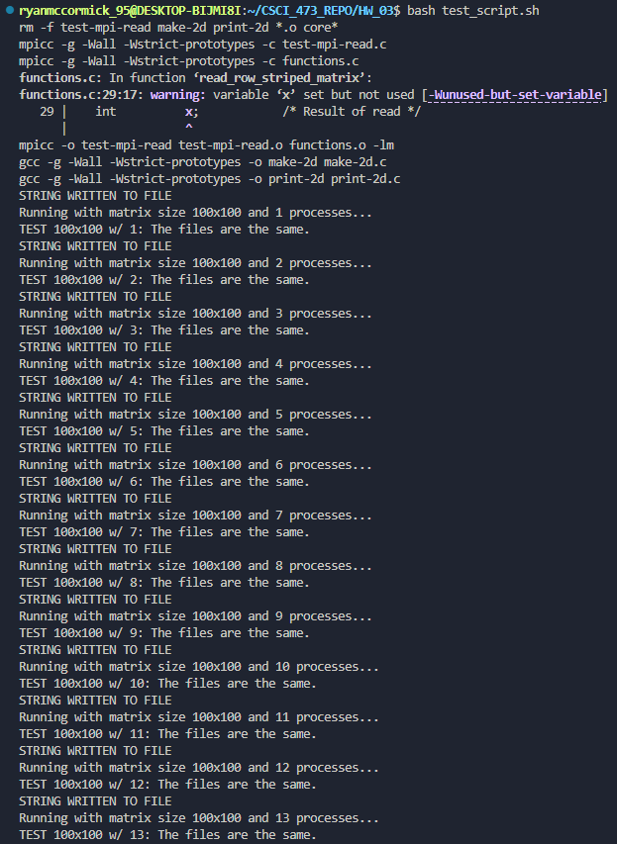
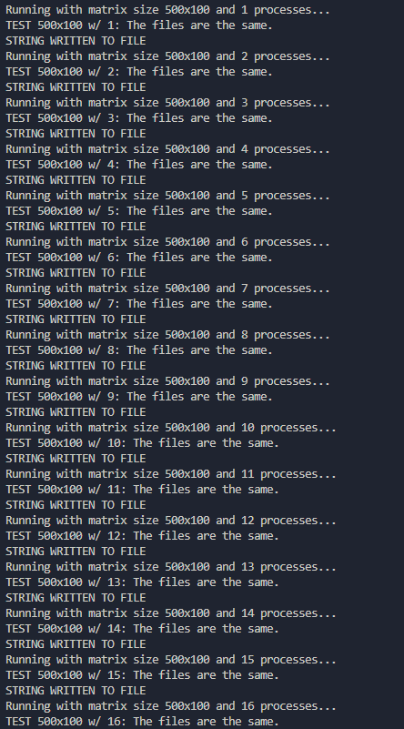
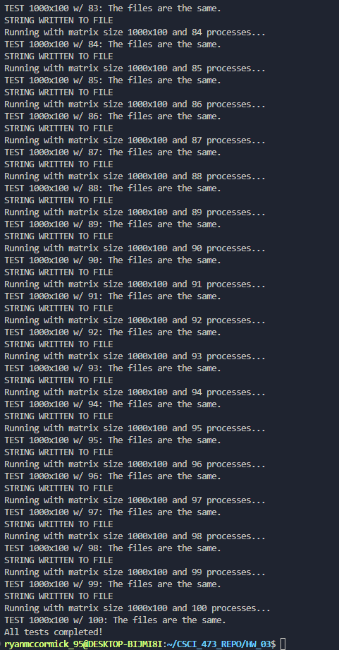
Screenshots from different steps of my test script running.

Slide 8
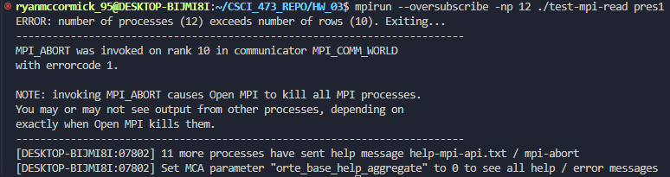
Added error handling for if the number of processors > number of rows.

